Slide 1
“To Eat or Not to Eat”… a Plant-based Diet?
Debate

Slide 2
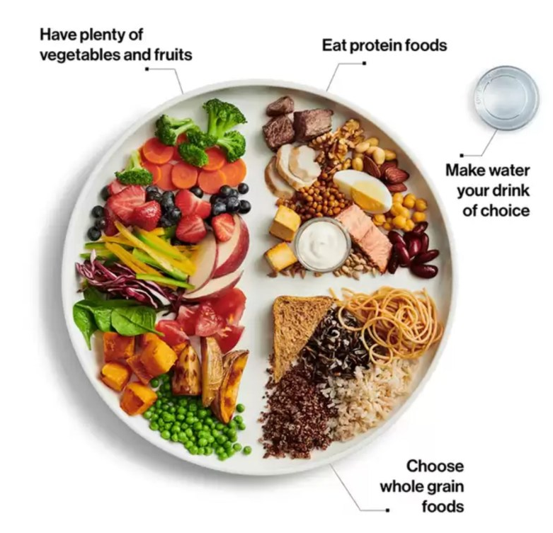
Plant-based Diet - Defined
Plant-based diet: A diet consisting mostly or entirely of foods derived from plants, including vegetables, grains, nuts, seeds, legumes and fruits, and with few or no animal products.
https://food-guide.canada.ca/en/

Slide 3
InstaPoll
Which of the following best characterizes your dietary pattern:
 | Plants | Dairy | Eggs | Fish/ Seafood | Poultry | Meat
Vegan | ✓
Lacto-vegetarian | ✓ | ✓
Ovo-vegetarian | ✓ |  | ✓
Lacto-ovo-vegetarian | ✓ | ✓ | ✓
Pescatarian | ✓ | ✓ | ✓ | ✓
Pollotarian | ✓ | ✓ | ✓ | ✓ | ✓
Flexitarian | ✓ | ✓ | ✓ | ✓ | ✓ | ✓^{(some)}
Omnivorous | ✓ | ✓ | ✓ | ✓ | ✓ | ✓
Carnivorous | ✓^{(some)} | ✓ | ✓ | ✓ | ✓ | ✓

Slide 4

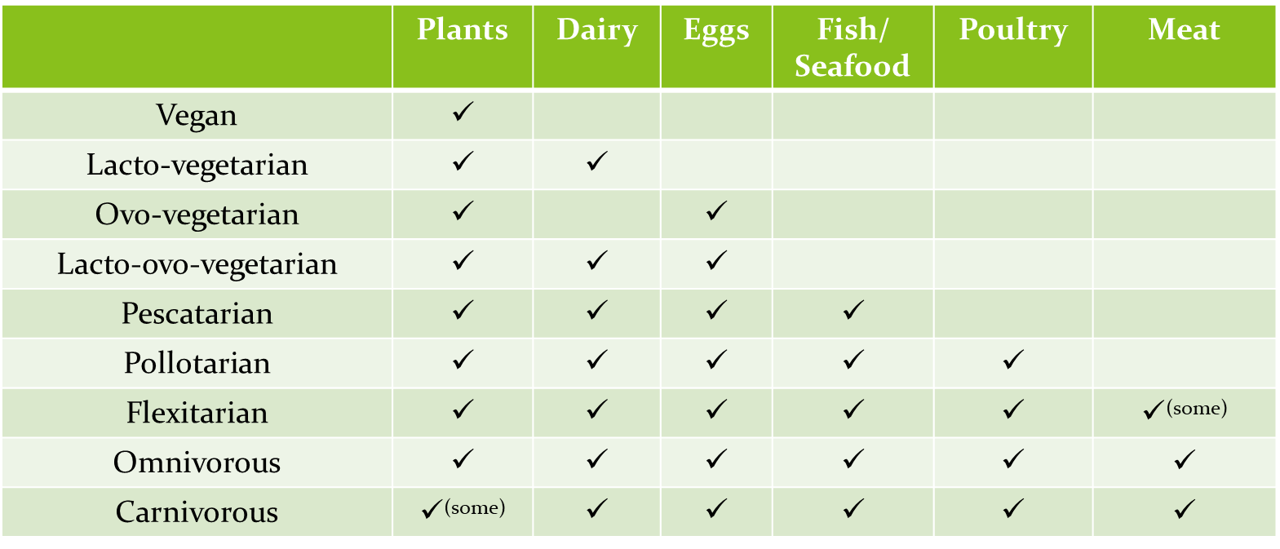
Current Dietary Guidelines Dietary Patterns
Healthy U.S.-Style Pattern, Healthy Vegetarian Pattern, & Healthy Mediterranean-Style Pattern:
Majority of energy from plant-based foods
Vegetables, Fruits, Legumes, Whole Grains, Nuts & Seeds
Provide protein & fats from nutrient-rich food sources
Seafood, Lean Meats & Poultry, Eggs, Legumes (Beans & Peas), Nuts & Seeds, & Soy
Limit intakes of added sugars, solid fats, & sodium.

Slide 5

Plant-Based Diet Chat
3 minute discussion in small group chat groups:
Do you support the idea of a ‘plant-based’ diet for ‘health’?
Why/Why not?

Slide 6
Debate Format
Each topic will have a point and counter-point
½ of the points will support & ½ will refute plant-based diets
Points will be ‘Plant-based’ (PLANT) vs. ‘Animal-based’ (ANIMAL) Diets
Michele: In-support of plant-based diets
Heather: Refuting plant-based diets
‘Ask a question’ will occur throughout the debate - feel to ask questions!
Check your biases at the door and openly listen to both sides

Slide 7
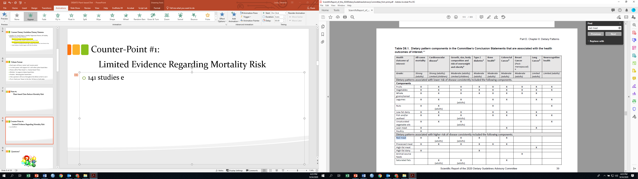
Point #1:
PLANT Diets Reduce Mortality Risk
Dietary Pattern Components Associated with Health

Slide 8
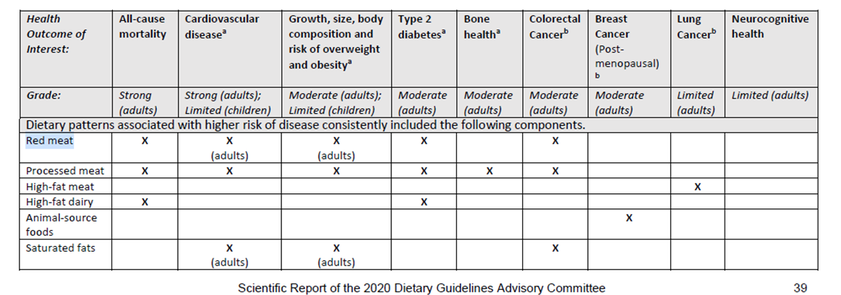
Point #1:
PLANT Diets Reduce Mortality Risk
Dietary Pattern Components Associated with Health

Slide 9

Counter #1:
Limited Evidence: PLANT DIETS Lower Mortality Risk
All data exist from cohort studies & only shows a relationship, not cause/effect
1950
2010
WHAT ELSE?
Smoking
Sedentary
Lifestyle
Stress
Fatty Meat
Desserts
Fried Food
Legumes
Added Sugar
Alcohol
Changes?
Mortality Risk
1950
2020
WHAT ELSE?
Exercise
Healthy
Mindset
Greens
Whole Fruit
Nuts
Legumes
Whole Grains
Seafood
Changes?
Animal-based
Plant-based
Dietary Pattern

Slide 10
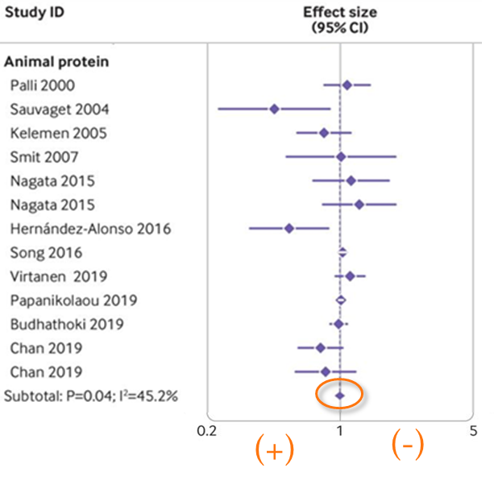
Counter #1:
Limited Evidence: PLANT DIETS Lower Mortality Risk
Relationship between (all) animal protein & mortality in 400,000 adults
Consuming animal proteins does not impact mortality risk.
Sina Naghshi et al. BMJ 2020;370:bmj.m2412

Slide 11

Questions?

Slide 12
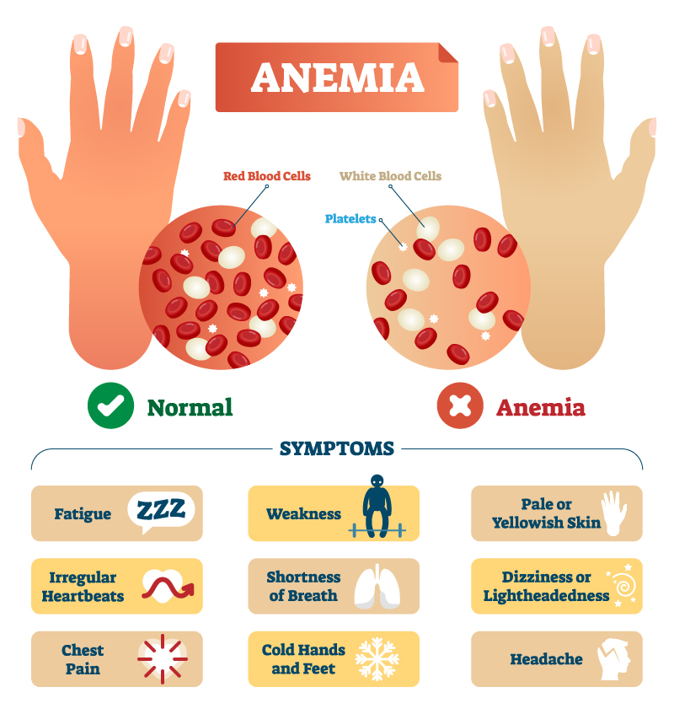
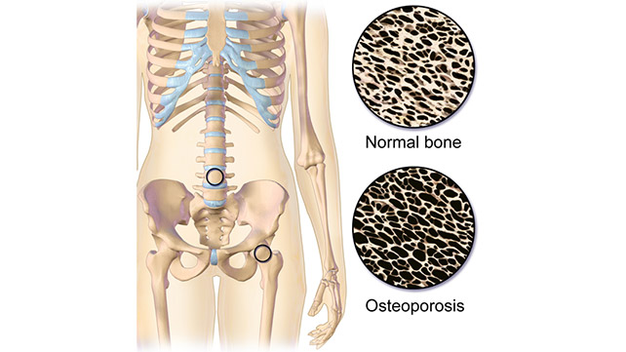
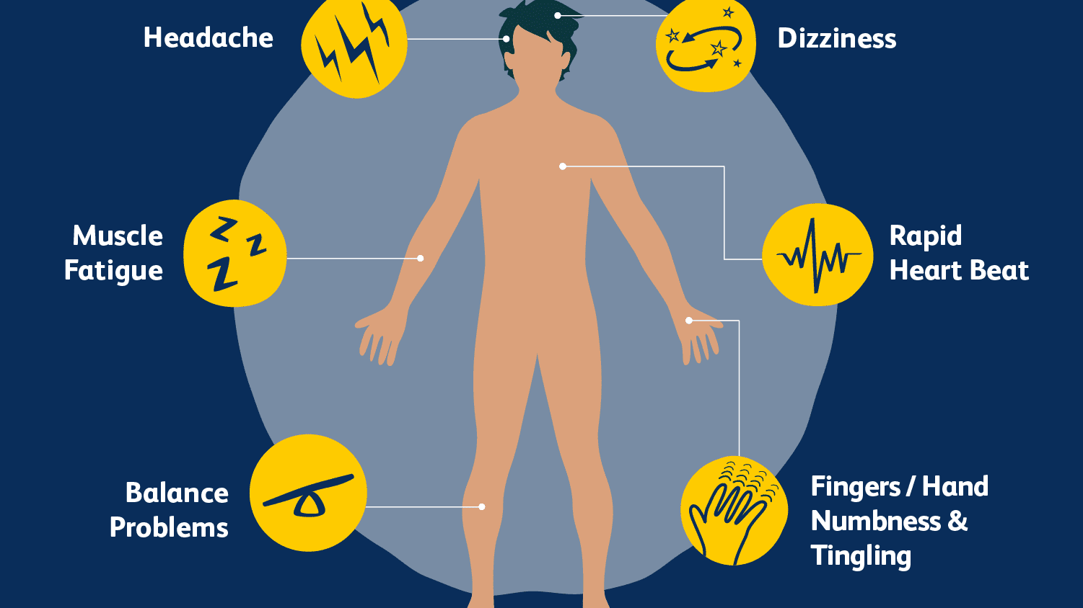
Point #2:
PLANT Diets Lead to Vitamin & Mineral Deficiencies
Low heme-iron
Best sources of heme iron: meat, poultry, & seafood
Low Calcium & Vit D
Best source of Ca & Vit D: dairy
Low Vit B-12
Best sources of Vit B-12: dairy, meat, eggs, seafood
https://www.eatrightpro.org/-/media/eatrightpro-files/practice/position-and-practice-papers/position-papers/vegetarian-diet.pdf

Slide 13
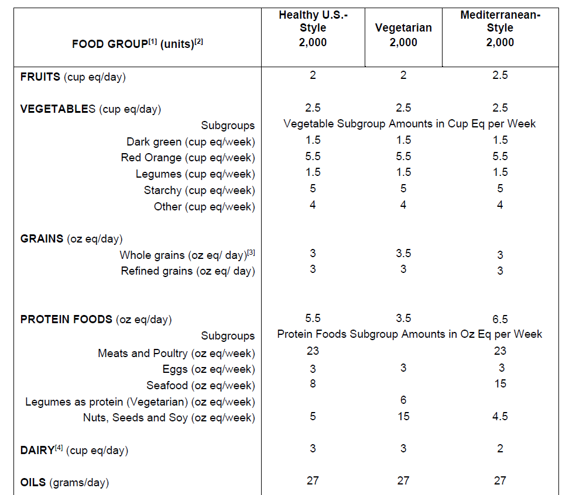
Counter #2:
PLANT Diets Can Meet Vitamin & Mineral Needs
Comparison of Food Groups and Food Subgroups between the three main plant-based patterns
(https://www.dietaryguidelines.gov/2020-advisory-committee-report/food-pattern-modeling/FPM-2-and-older).

Slide 14
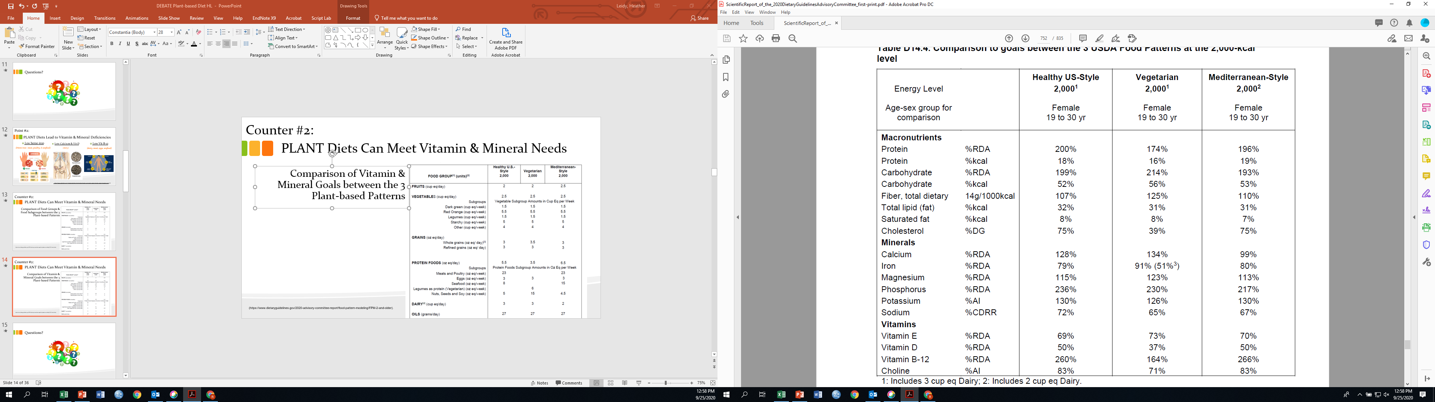
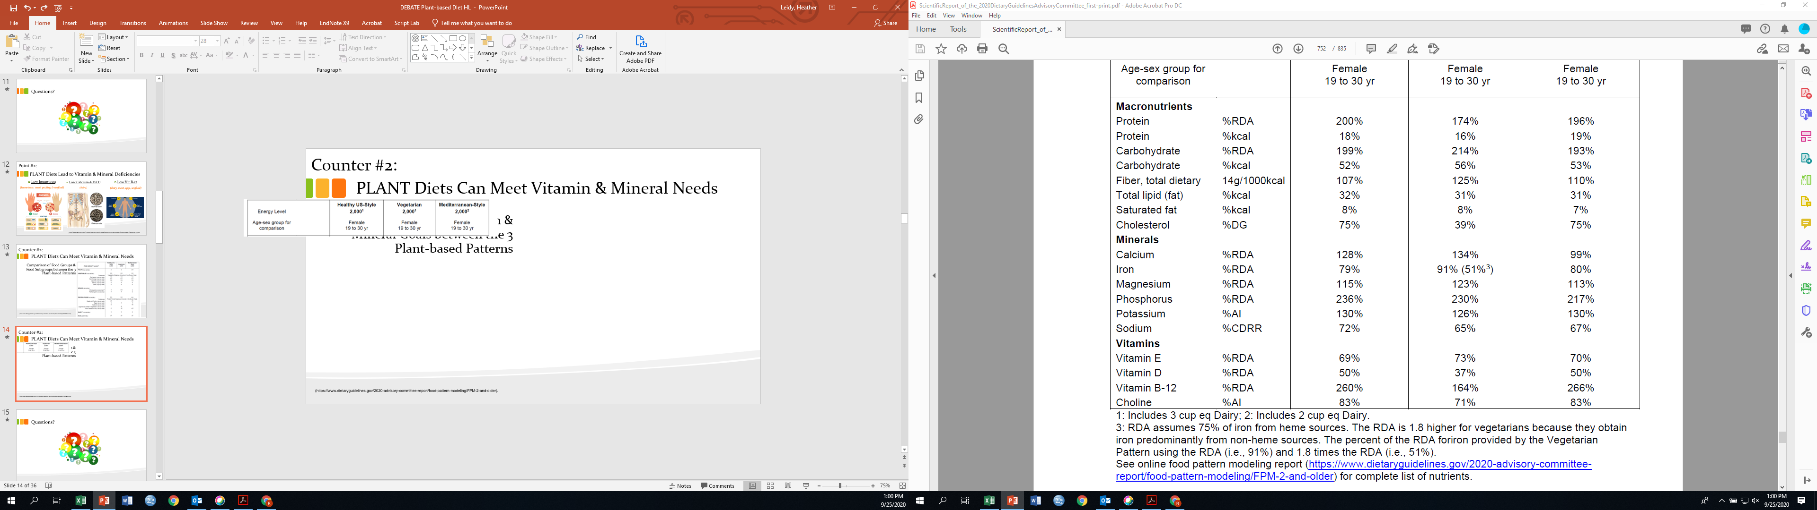
Counter #2:
PLANT Diets Can Meet Vitamin & Mineral Needs
Comparison of vitamin and mineral goals between the three main plant-based patterns
(https://www.dietaryguidelines.gov/2020-advisory-committee-report/food-pattern-modeling/FPM-2-and-older).

Slide 15
Questions?

Slide 16
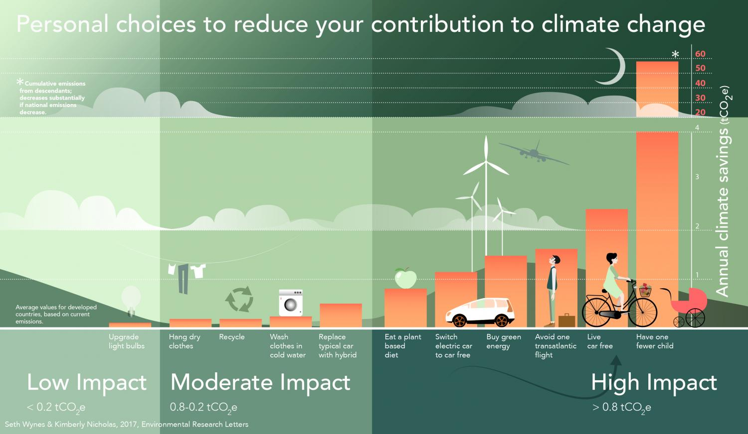
Point #3:
PLANT Diets Are Better for the Environment –
Carbon Footprint

Slide 17
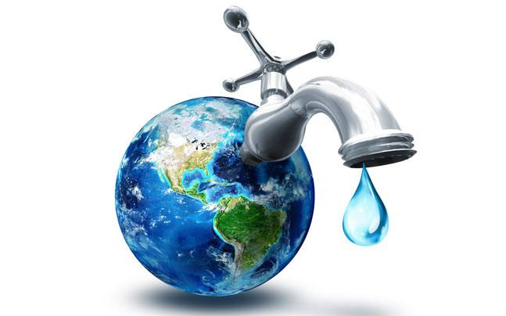

Point #3:
PLANT Diets Are Better for the Environment –
Water Conservation

Slide 18
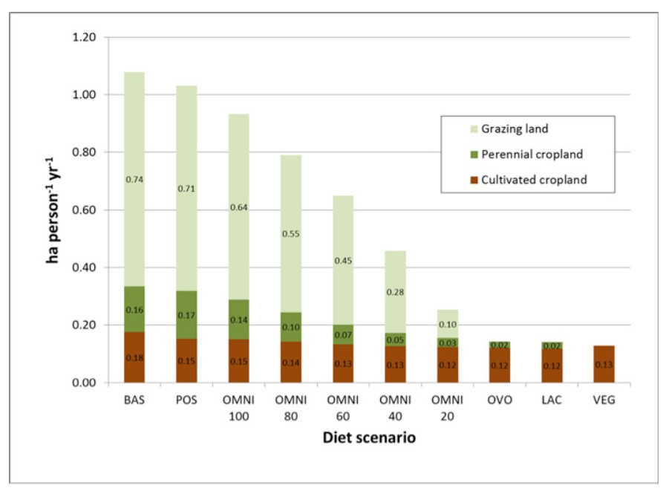
Point #3:
PLANT Diets Are Better for the Environment –
Land Sustainability
“The researchers concluded that a strategic shift toward a plant-based diet could reduce the amount of land needed to feed U.S. consumers and at the same time increase the number of people who can be fed from our agricultural resources.
The result could be more food — without the need to clear more land — for hundreds of millions of people around the globe.”
1 ha ≈ 2 football fields
https://ensia.com/notable/which-diet-makes-best-use-of-farmland-you-might-be-surprised/#:~:text=The%20researchers%20concluded%20that%20a,fed%20from%20our%20agricultural%20resources.

Slide 19
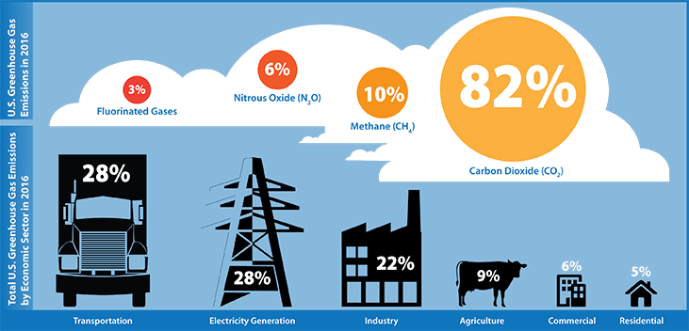
Counter-Point #3:
ANIMAL Diets Aren’t as Bad as You Think!
(Carbon Footprint)
4% livestock
Agriculture livestock contribute minimally to gas emissions

Slide 20
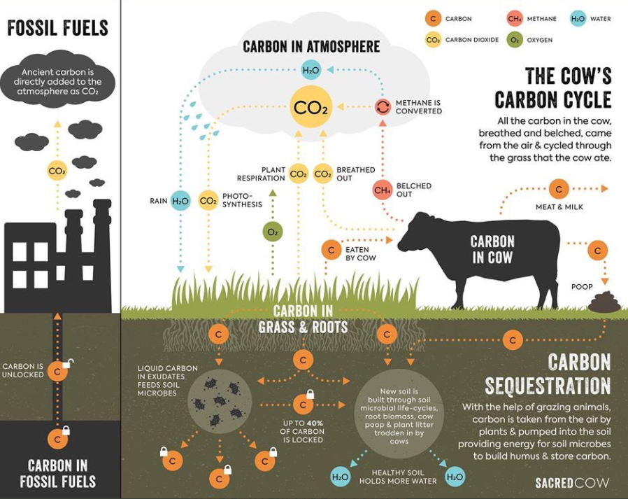
Counter-Point #3:
ANIMAL Diets Aren’t as Bad as You Think!
(Carbon Footprint)
Livestock are part of carbon cycle & NOT making new fossil fuels

Slide 21
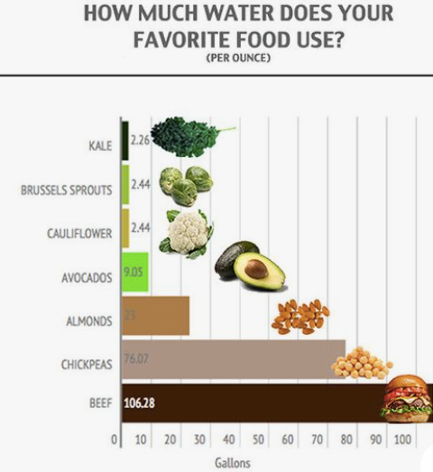
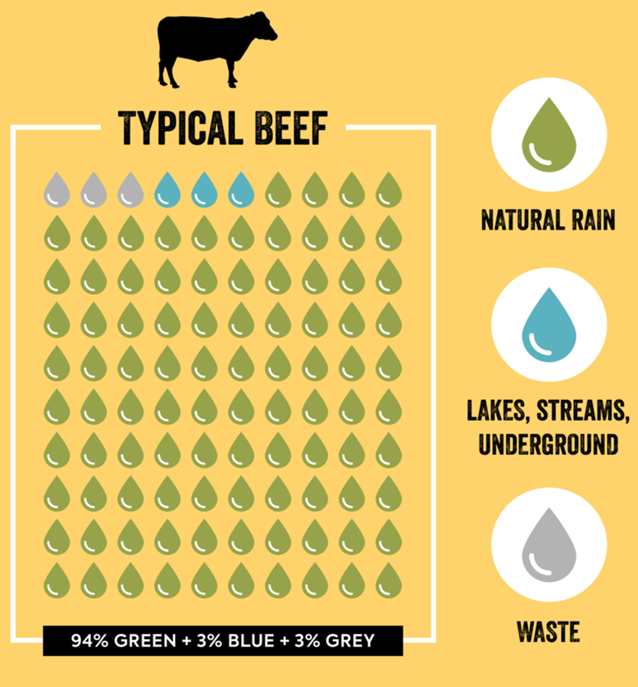
Counter #3:
ANIMAL Diets Aren’t as Bad as You Think!
(Water Usage)
Plants require a substantial amount of water (from irrigation)
Beef requires the most water but majority comes from rain water.

Slide 22
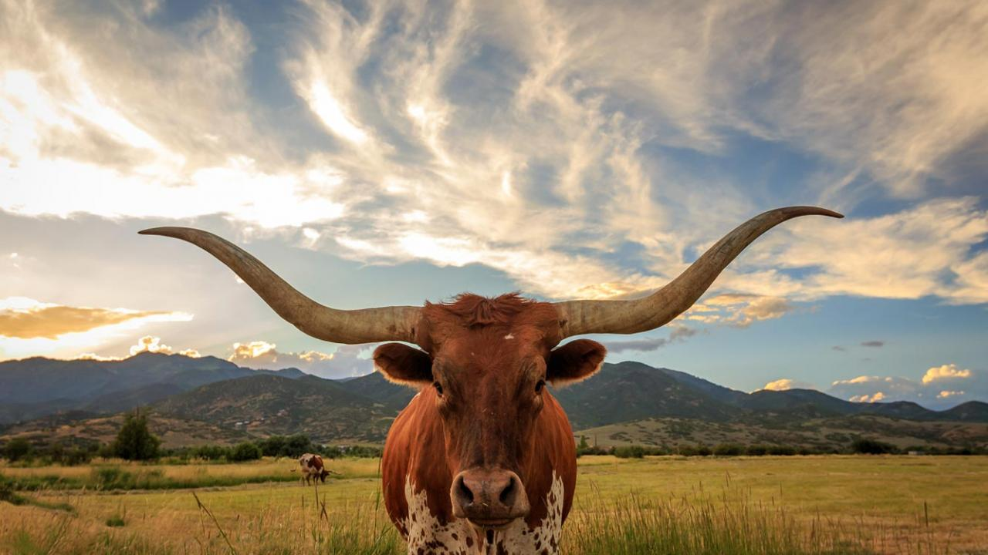
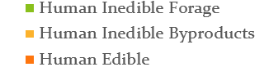
Counter #3:
ANIMAL Diets Aren’t as Bad as You Think!
(Land Usage)
Beef use land that is not suitable for growing crops (for humans)

Slide 23
Questions?

Slide 24
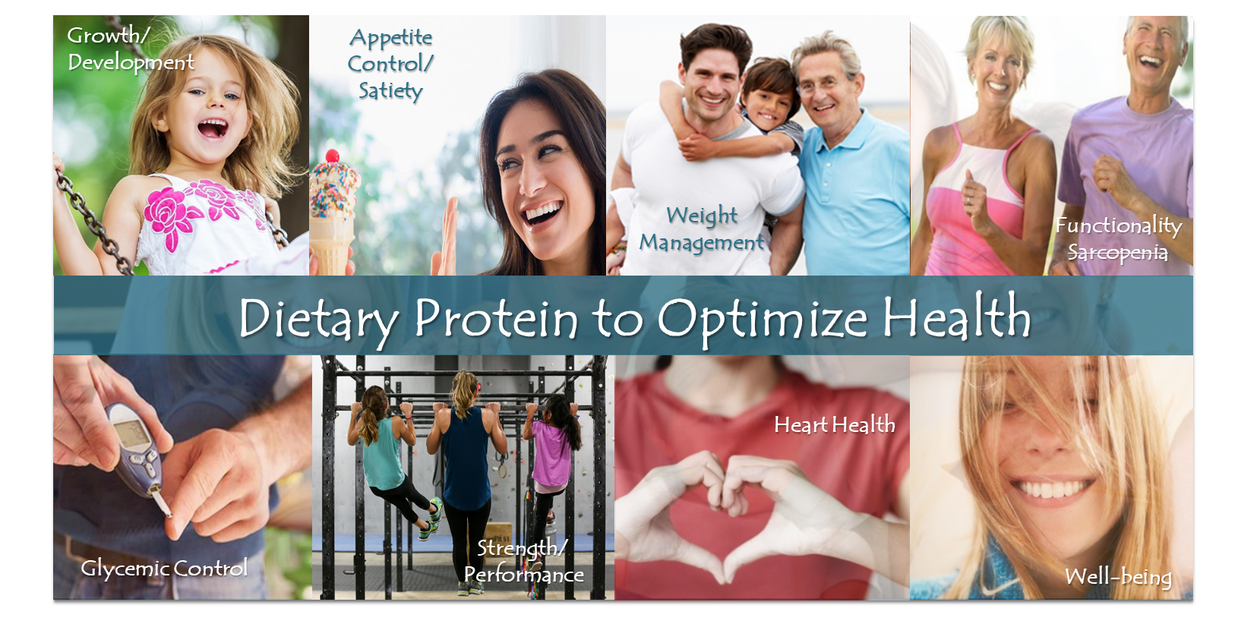
Point #4:
PLANT Diets are Low (sub-optimal) in Protein Quantity
 | Meat-eaters | Fish-Eaters | Lacto-ovo Vegetarians | Vegans
Sample size | 18,244 | 4,531 | 6,673 | 803
Energy (kcal) | 2090 | 2030 | 2000 | 1950
Protein (% of energy) | 17 | 16 | 14 | 13
Protein (g/kg bw/d) | 1.28 | 1.17 | 1.04 | 0.99
Protein (g) | 90 | 79 | 70 | 64
DRI/RDA
Optimal
10-35%
20-35%
0.8
1.2-1.6
50-80g
90-120g
https://www.ncbi.nlm.nih.gov/pmc/articles/PMC6893534/pdf/nutrients-11-02661.pdf

Slide 25
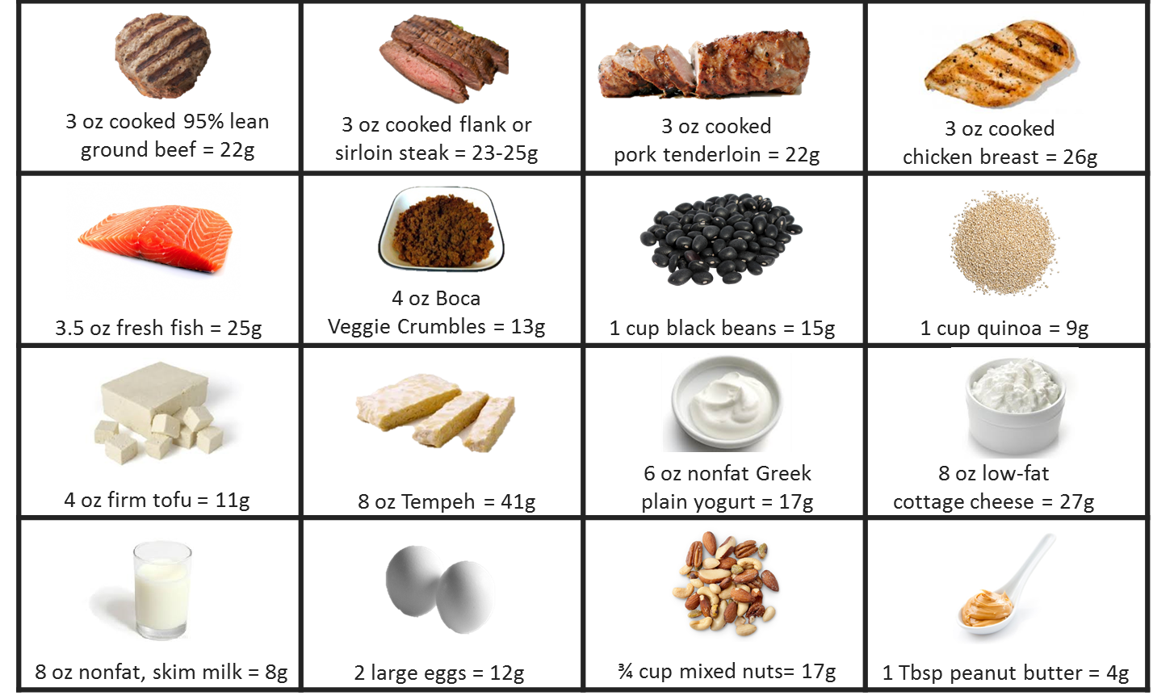
Point #4:
PLANT Diets are Low (sub-optimal) in Protein Quantity
Protein Quantity Per Serving

Slide 26
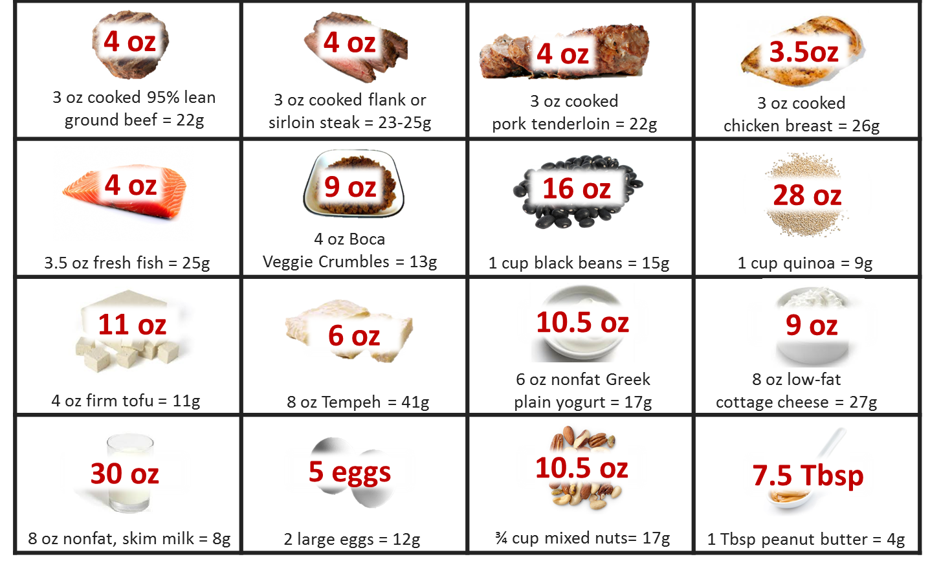
Point #4:
PLANT Diets are Low (sub-optimal) in Protein Quantity
180 kcals
Amount Needed to Achieve the ‘30 g’
High quality animal proteins are excellent sources due to their
high protein density
low energy density
650 kcals
1,800 kcals
700 kcals
230 kcals

Slide 27
Point #4:
PLANT Diets are Low (sub-optimal) in Protein Quality
Food | PDCAAs (0-1.00)
Whey & Casein | 1.00
Whole Eggs | 1.00
Meat | 1.00
Soy Protein Isolate | 0.98
Pea Protein Isolate | 0.89
Chickpeas (legume) | 0.74
Rice | 0.62
Tofu | 0.56
Almonds | 0.39
Collagen | 0.0
Leucine Content (%)
13
9
8
8
8
8
8
7
7
3
Same amount of protein ≠ same quality
Amino Acid Composition
Types (essential) – higher in animal
Amount of essentials – higher in animal
Digestibility
Higher in animal
LEU is key (from a muscle perspective)
https://health.gov/sites/default/files/2019-09/2015-2020_Dietary_Guidelines.pdf

Slide 28
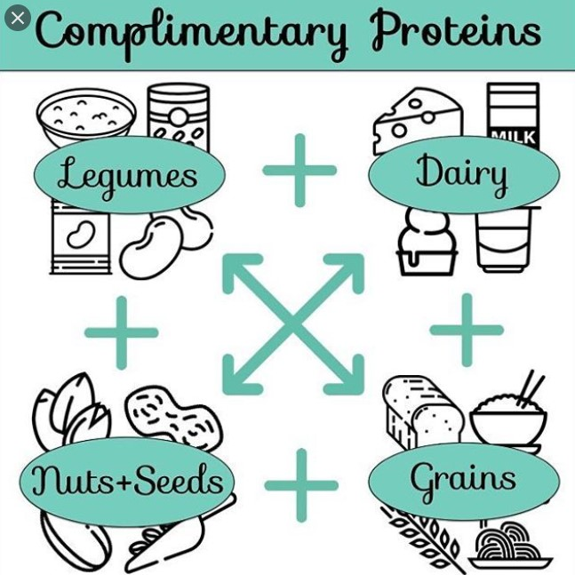
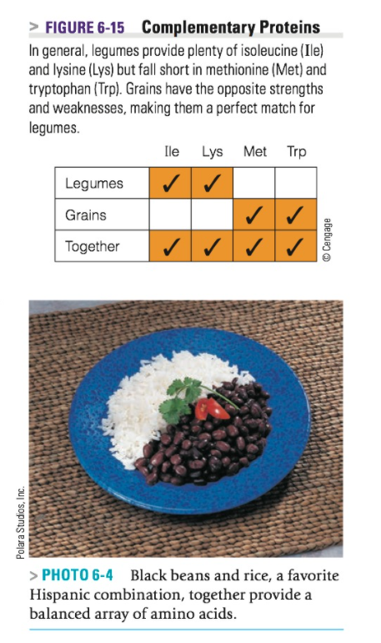
Counter#4:
PLANT Diets Can Contain Adequate Amounts of
High-Quality Protein
https://i.pinimg.com/originals/ac/16/4a/ac164a1f184d7d3f2b76dbf94872e66d.jpg

Slide 29
Questions?

Slide 30
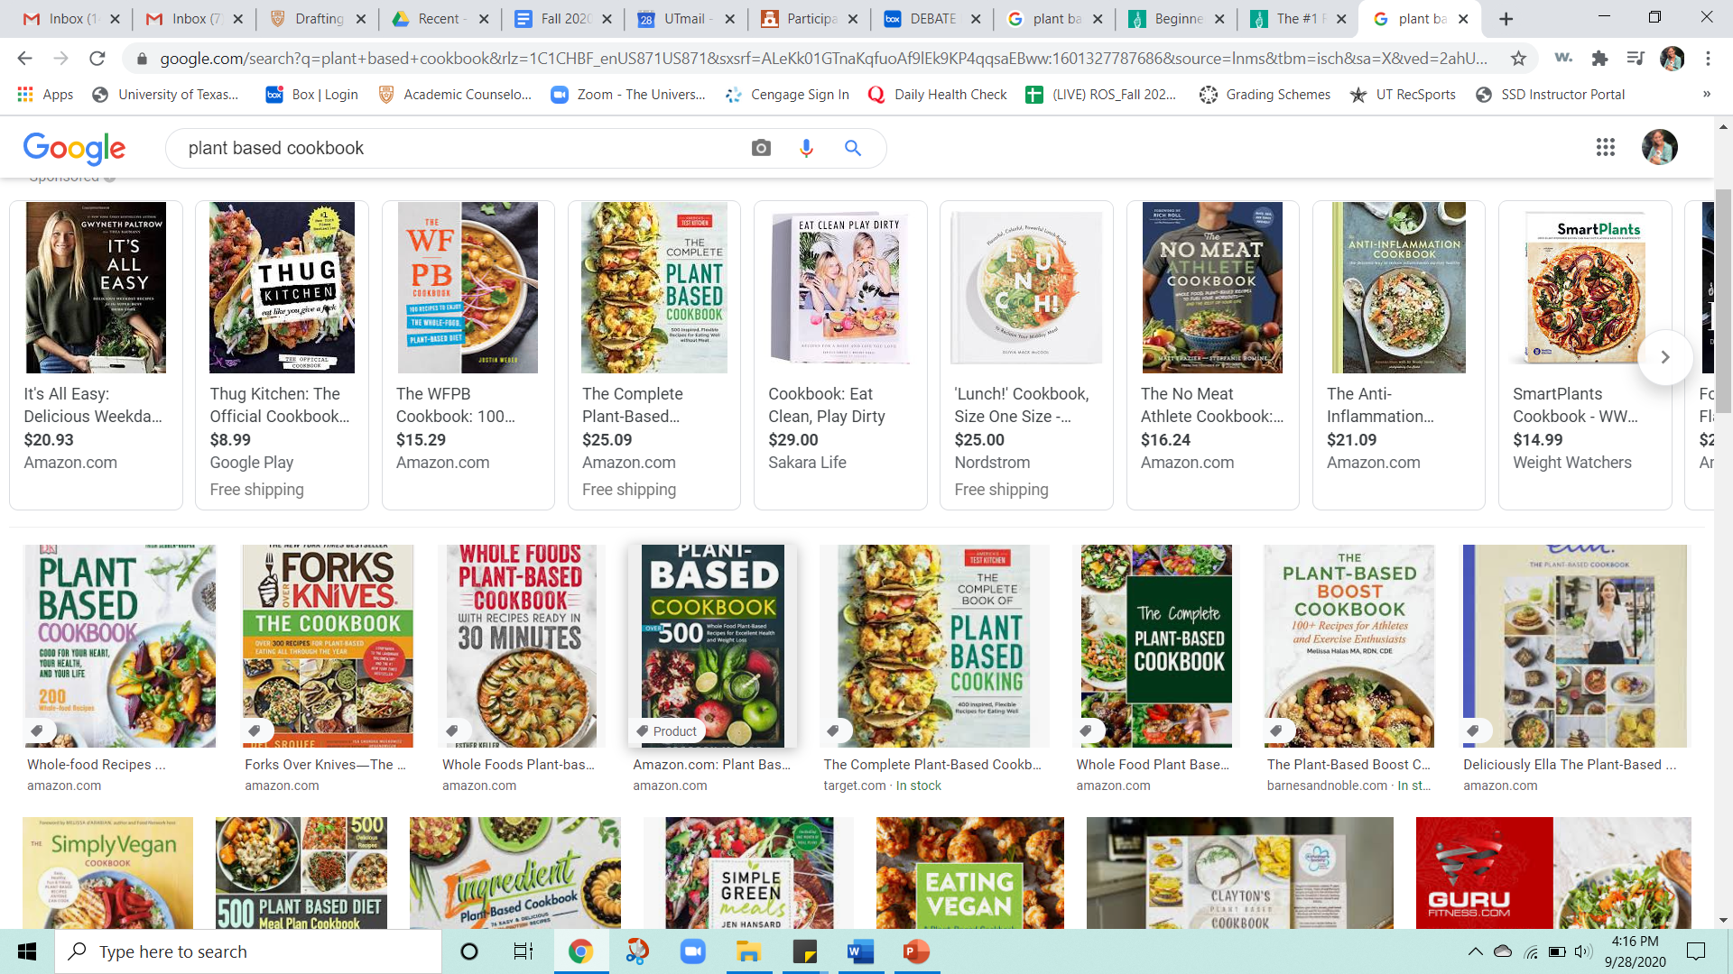
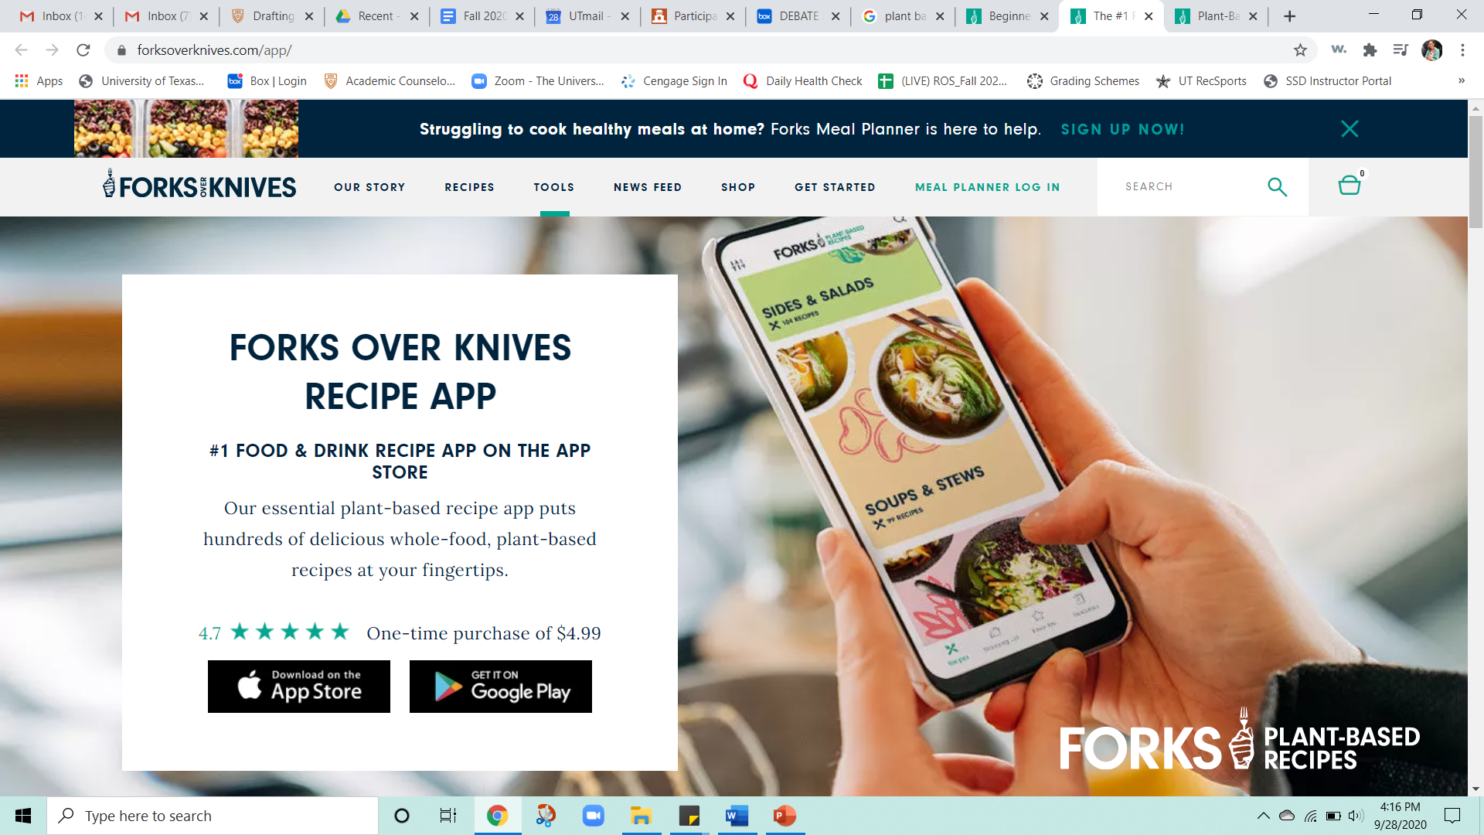
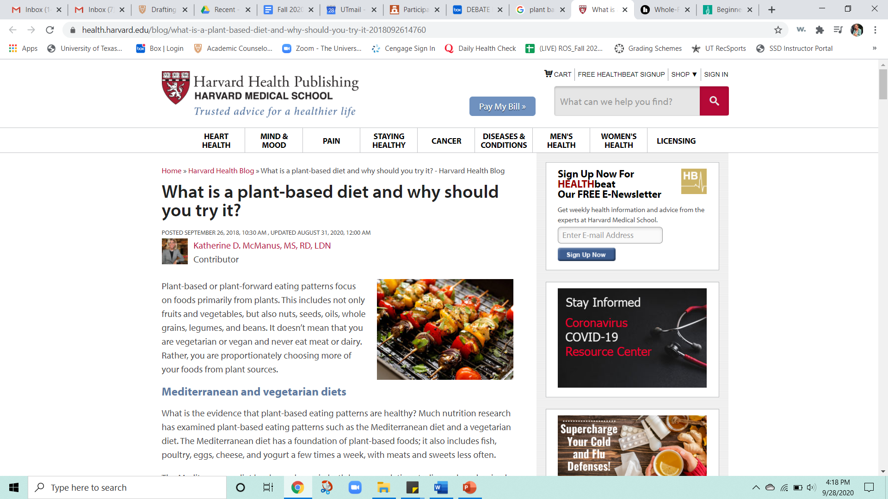
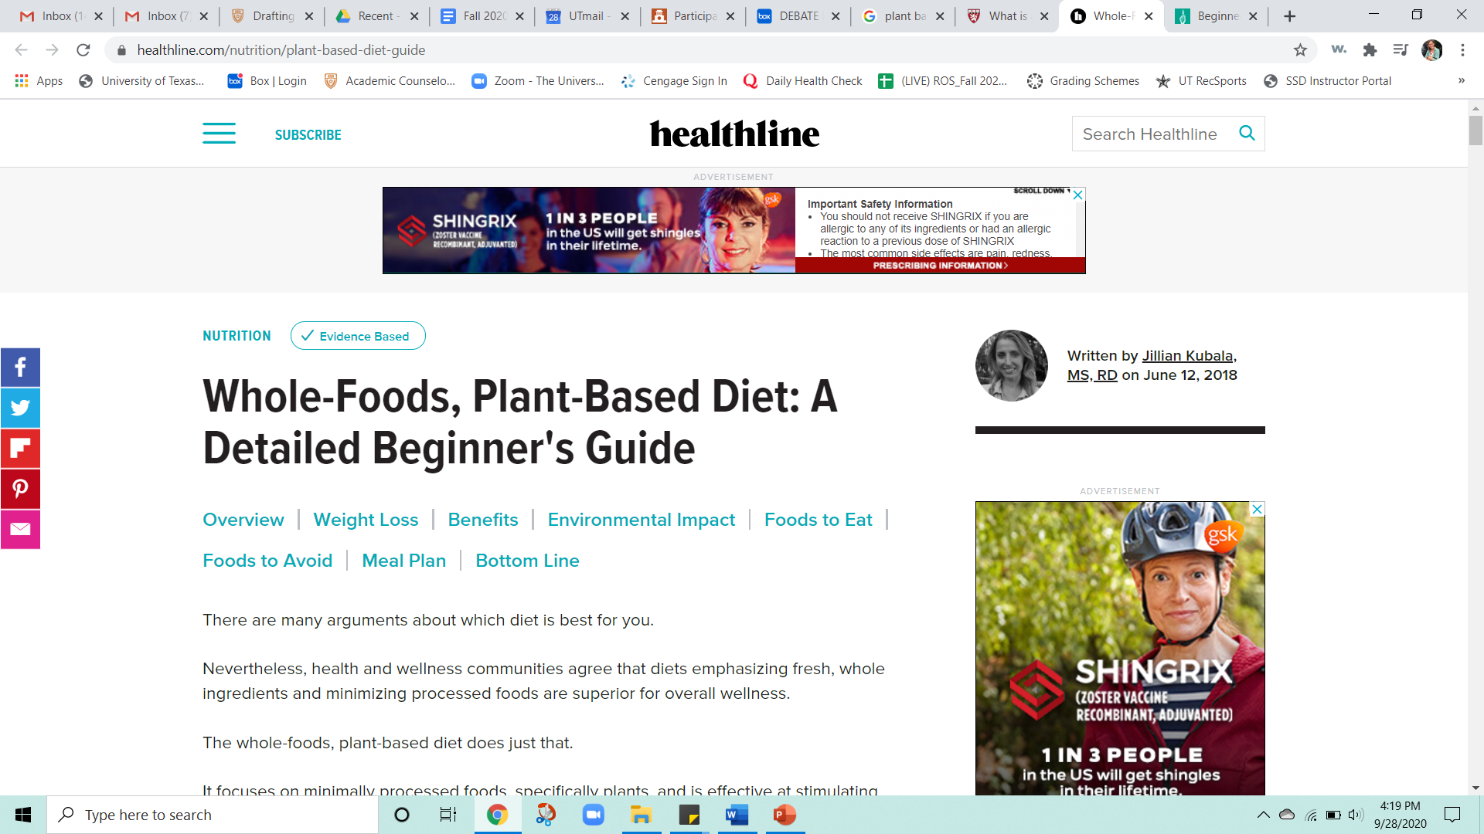
Point #5:
PLANT Diets are Easy to Follow and Taste Great!

Slide 31
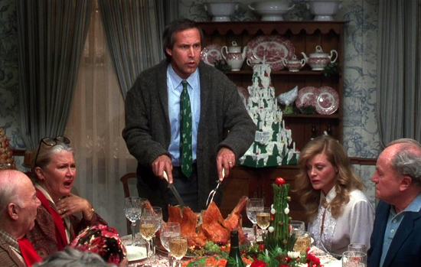

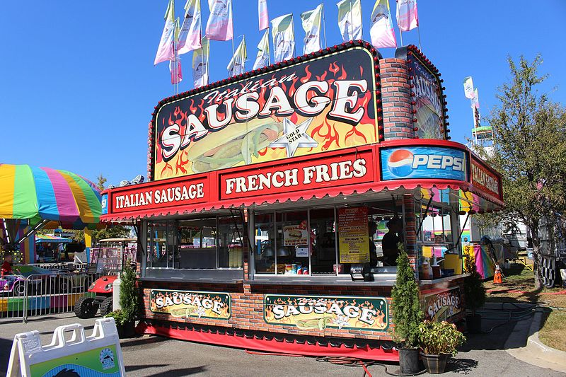

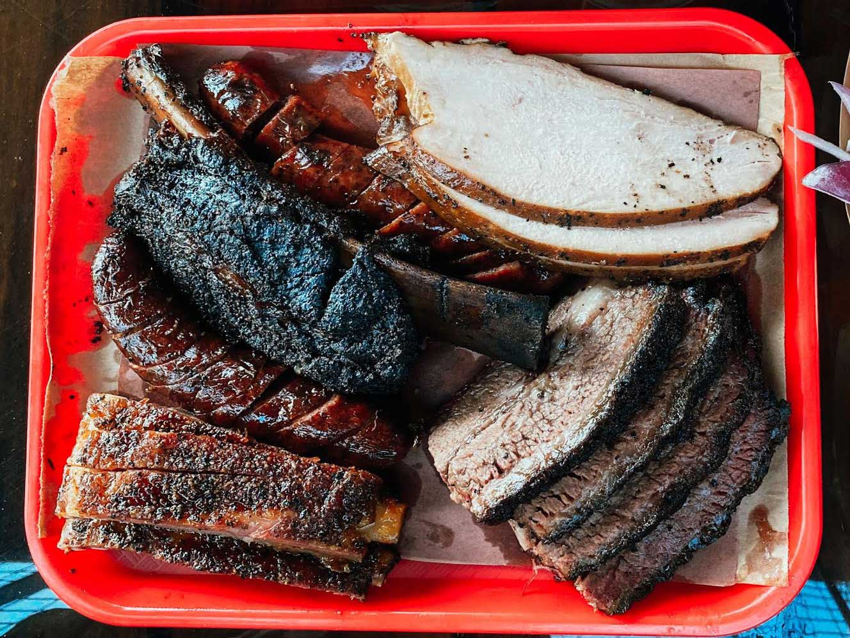
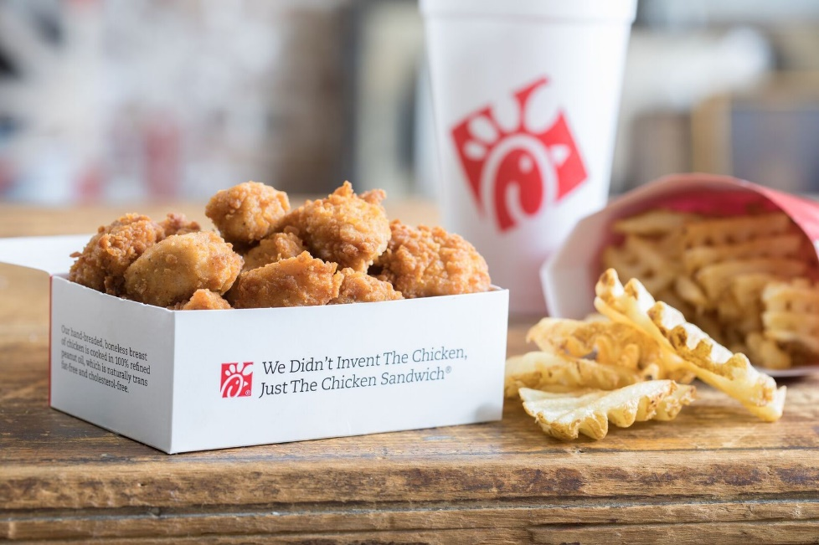
Counter #5:
If that was true, we’d all be following them……..
And…….we aren’t
Family Memories
Hanging Out
Summer Fun
Taste
Convenience/Cost

Slide 32
Questions?

Slide 33
Plant-Based Diet Chat
3 minute discussion in small group chat groups:
Did you change your viewpoint on ‘plant-based’ diets for ‘health’?
Why/Why not?

Slide 34
Install Poll
Taking everything into consideration, which side do you now support?
There is no benefit to consuming animal-based foods in our diet.
The harm (of consuming animal-based foods) outweighs the benefits.
An ideal diet can (and should) include nutrient-dense animal-based and plant-based foods.
Not sure.

Slide 35
Wrap -up
Position Summary (for Debate)
1 page, double-spaced (see syllabus)
Due Tues, April 6th (upload to Canvas)
Quiz #3
DUE Sunday, March 28th at 11:59 pm
Mid-term: Chapters 1-7 + plant-based diet debate
Mid-term review session - Tues, March 30th
Opens April 1st at 12:01am
DUE April 4th at 11:59pm
No class on April 1st
Reminder: Dietary Analysis Project DUE April 8th
Instapoll results

